Slide 1
Cornerstone City Church Peninsula Plus Community Hoo Are Ya
29th June 2025

Slide 2


Slide 3
Thanksgiving
CCLI Song # 7199589
Nick Herbert | Taku Mudere | Zo Chilengwe
© Capitol CMG Genesis; Safe and Sound Music; Remaining portion is unaffiliated
For use solely with the SongSelect® Terms of Use. All rights reserved. www.ccli.com
CCLI Licence No. 33265

Slide 4
1/8
Enter in (Enter in)
His courts with praise (His courts with praise)
For He is greatly (He is greatly)
To be praised (To be praised)

Slide 5
2/8
What shall we do
We shall lift up a shout
What shall we do
We shall praise Him
What shall we do
For our God made a way
We'll give Him our thanksgiving

Slide 6
3/8
Magnify (Magnify)
His Holy Name (His Holy Name)
For He is greatly (For He is greatly)
To be praised (To be praised)

Slide 7
4/8
What shall we do
We shall lift up a shout
What shall we do
We shall praise Him
What shall we do
For our God made a way
We'll give Him our thanksgiving

Slide 8
5/8
Even if the rocks cry out
We're gonna drown them out
With a louder shout of praise
Even when the battles roar
We're gonna praise You Lord
'Cause You are always worthy

Slide 9
6/8
You are worthy
Worthy of honour and praise
You are worthy
We'll sing it again and again

Slide 10
7/8
What shall we do
We shall lift up a shout
What shall we do
We shall praise Him
What shall we do
For our God made a way
We'll give Him our thanksgiving

Slide 11
8/8
We'll give Him our thanksgiving
We'll give Him our thanksgiving

Slide 12
I Walk By Faith
CCLI Song # 464834
Chris Falson
© 1990, 1999 Universal Music - Brentwood Benson Publishing
For use solely with the SongSelect® Terms of Use. All rights reserved. www.ccli.com

Slide 13
1/2
I walk by faith each step by faith
To live by faith I put my trust in You
I walk by faith each step by faith
To live by faith I put my trust in You

Slide 14
2/2
Ev'ry step I take is a step of faith
No weapon formed against me shall prosper
And ev'ry prayer I make is a prayer of faith
If my God is for me who can be against me

Slide 15
Your Mercy Flows
Dele Olajide

Slide 16
1/7
Your mercy flows
Like a river through my soul
Your love came down and
Picked me off the ground
As your grace abounds,
I lift my voice in praise

Slide 17
2/7
Praise the Lord with me
Lift your voice and sing
'Cos there is no one like Him
Jesus our King

Slide 18
3/7
Praise the Lord with me
Move your feet and dance
Cos there is a second chance
With Jesus our King

Slide 19
4/7
Your Spirit calls my heart to receive
Forgiveness free, even for me
As your grace abounds, my fears all fade away

Slide 20
5/7
Praise the Lord with me
Lift your voice and sing
'Cos there is no one like Him
Jesus our King

Slide 21
6/7
Praise the Lord with me
Move your feet and dance
Cos there is a second chance
With Jesus our King

Slide 22
7/7
Lift your voice, move your feet,
Let the praise begin
Sing a song, move your body
Let those praises ring
'Cos there is no one like Him
Jesus our King

Slide 24
Bless God
CCLI Song # 7206380
Brandon Lake | Brooke Ligertwood | Cody Carnes
© 2023 Brandon Lake Music; Brooke Ligertwood Designee; Capitol CMG Paragon; Writer's Roof Publishing
For use solely with the SongSelect® Terms of Use. All rights reserved. www.ccli.com

Slide 25
1/11
Blessed are those who run to Him
Who place their hope and confidence in Jesus
He won’t forsake them
Blessed are those who seek His face
Who bend their knee and fix their gaze on Jesus
They won’t be shaken

Slide 26
2/11
Come on and praise the Lord with me
Sing if you love His name
Come on and lift your voice with me
He’s worthy of all our praise

Slide 27
3/11
Blessed are those who walk with Him
Whose hearts are set on pilgrimage with Jesus
They’ll see His glory
Blessed are those who die to live
Whose joy it is to give it all for Jesus
And for Him only
Oh Jesus all for Your glory

Slide 28
4/11
Come on and praise the Lord with me
Sing if you love His name
Come on and lift your voice with me
He’s worthy of all our praise

Slide 29
5/11
Come on and bring your offering
Sing if you’ve known His grace
Come on and lift up your holy hands
He’s worthy of all our praise

Slide 30
6/11
Bless God in the sanctuary
Bless God in the fields of plenty
Bless God in the darkest valley
Every chance I get I bless Your name

Slide 31
7/11
Bless God when my hands are empty
Bless God with a praise that costs me
Bless God when nobody’s watching
Every chance I get I bless Your name

Slide 32
8/11
Bless God when the weapon’s forming
Bless God when the walls are falling
Bless God ‘cause He goes before me
Every chance I get I bless Your name

Slide 33
9/11
Bless God for He holds the vict’ry
Bless God for He’s always with me
Bless God for He’s always worthy
Every chance I get I bless Your name (REPEAT)
Every chance I get

Slide 34
10/11
Come on and praise the Lord with me
Sing if you love His name
Come on and lift your voice with me
He’s worthy of all our praise

Slide 35
11/11
Come on and bring your offering
Sing if you’ve known His grace
Come on and lift up your holy hands
He’s worthy of all our praise He’s worthy of all our praise
He’s worthy of all our praise

Slide 36
10,000 Reasons
CCLI Song # 6016351
Jonas Myrin | Matt Redman
© 2011 Thankyou Music (Admin. by Integrity Music Ltd)
Atlas Mountain Songs (Admin. by SHOUT! Music Publishing UK)
For use solely with the SongSelect® Terms of Use. All rights reserved. www.ccli.com
CCLI Licence No. 33265

Slide 37
1/7
Bless the Lord O my soul O my soul
Worship His holy name
Sing like never before O my soul
I'll worship Your holy name

Slide 38
2/7
The sun comes up it's a new day dawning
It's time to sing Your song again
Whatever may pass and whatever lies before me
Let me be singing when the evening comes

Slide 39
3/7
Bless the Lord O my soul O my soul
Worship His holy name
Sing like never before O my soul
I'll worship Your holy name

Slide 40
4/7
You're rich in love and You're slow to anger
Your name is great and Your heart is kind
For all Your goodness I will keep on singing
Ten thousand reasons for my heart to find

Slide 41
5/7
Bless the Lord O my soul O my soul
Worship His holy name
Sing like never before O my soul
I'll worship Your holy name

Slide 42
6/7
And on that day when my strength is failing
The end draws near and my time has come
Still my soul will sing Your praise unending
Ten thousand years and then forevermore

Slide 43
7/7
Bless the Lord O my soul O my soul
Worship His holy name
Sing like never before O my soul
I'll worship Your holy name

Slide 45


Slide 46
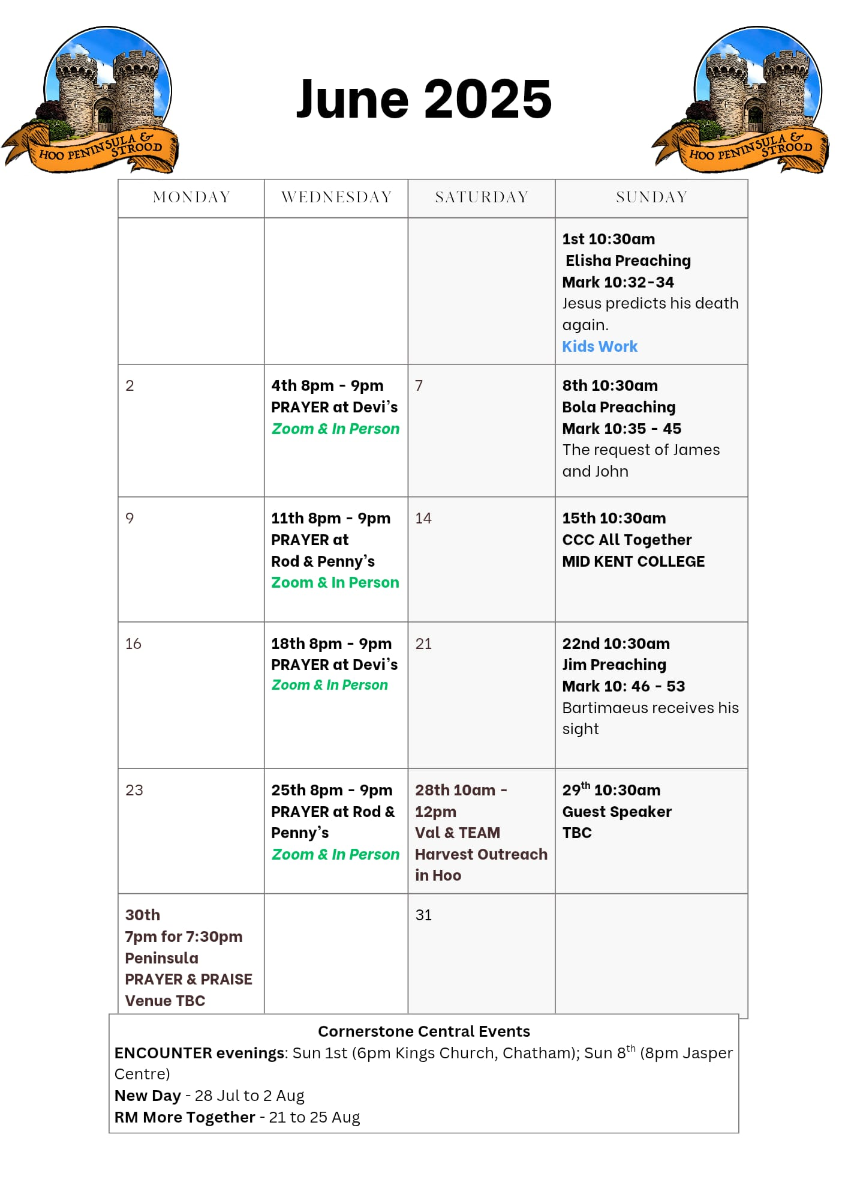

Slide 47


PPP God Whispers

Slide 48


Slide 49


Slide 50


Slide 51

Grow Group 1
On YOUR MARK!

Slide 52
Leaders
Leaderss
Phil & Kim
Maria (Mia) Warren
Matthew Harrison
Richard & Elisha Acheampong
Phil & Kim
Maria (Mia) Warren
Matthew Harrison
Richard & Elisa Acheampong

Slide 53

Storm Walker
Storm Walker
Symbolising, trust in Jesus Christ through life's storms.
Mark 4:35-41

Slide 54


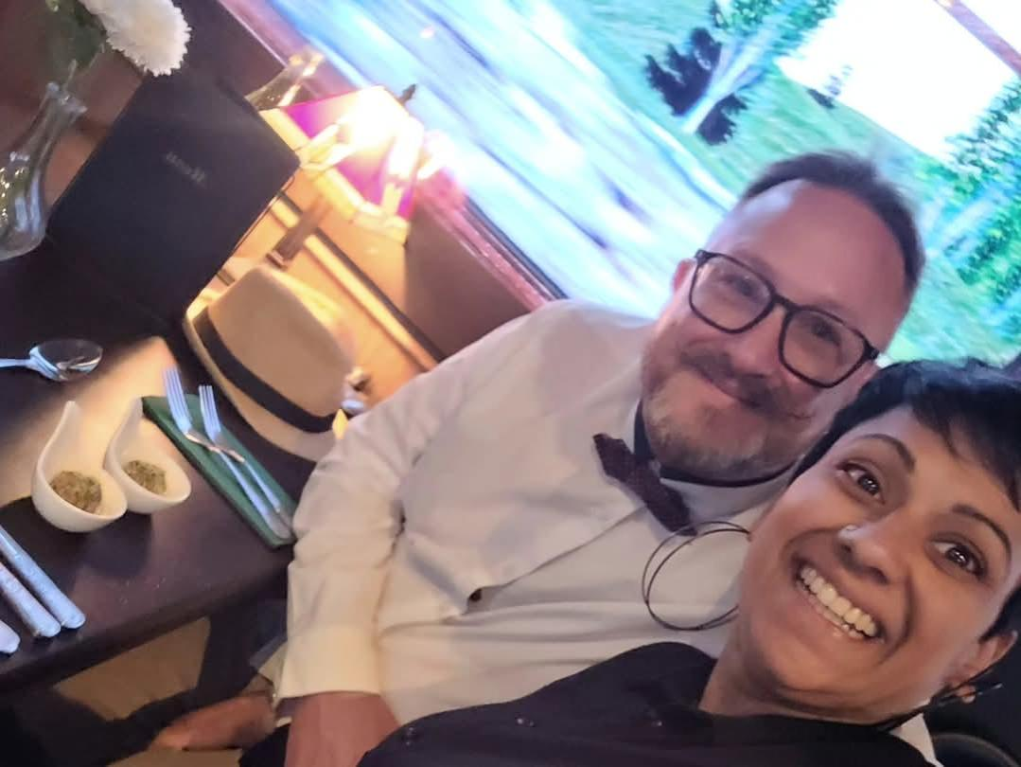
Group Leaders
Micheal and Mwamba
Wilfred and Parveen
Hannah

Slide 55
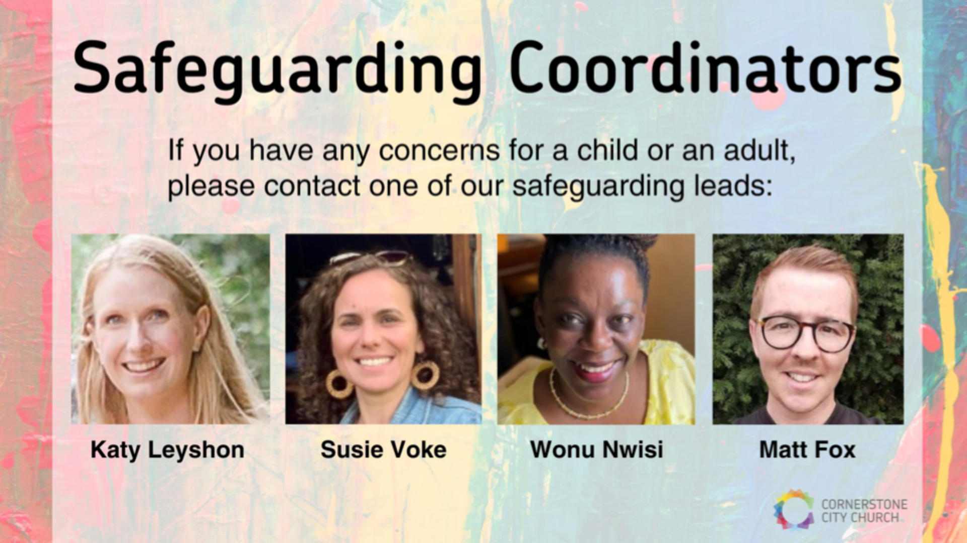

Slide 56
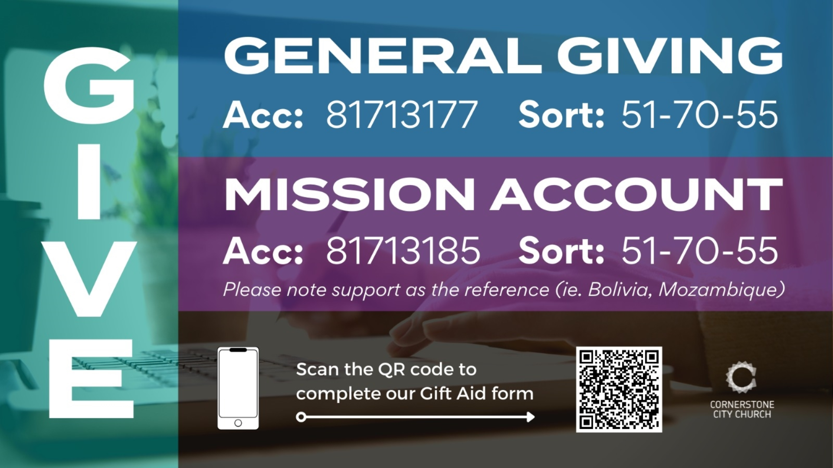

Slide 57


Slide 58


Slide 59
2 Corinthians 14 May the grace of the Lord Jesus Christ, and the love of God, and the fellowship of the Holy Spirit be with you all
Surely goodness and mercy shall follow me all the days of my life, and I shall dwell in the house of the Lord forever.

